Slide 1
SW 332
EVENTURE
EVENT MANAGEMENT SYSTEM

Slide 2
Agenda Overview
01
02
03
04
Introduction
Product vision
Stackholders
Scrum Team
05
06
07
08
Summary of the product
Product Backlog
Sprint Baclog
Scrum metting

Slide 3

Introduction
The Event Management System is a smart digital platform that simplifies planning and managing events like conferences, workshops, and social gatherings. It allows organizers to create events, manage registrations and tickets, send notifications, and track attendance easily. With a secure, user-friendly interface, it enhances communication and provides an efficient, time-saving experience.
Overall, this system provides a comprehensive, time-saving, and reliable experience that simplifies event management and enhances user satisfaction.

Slide 4

For | Event organizers and attendees
Who | Need an easy and secure platform to manage and attend events
The | Complete digital system for event management
That | Enables users to create events, manage tickets, send notifications, and manage attendance
Unlike | Manual systems or separate tools
Our product | Is a game-changer because it provides a smooth and secure experience for managing and tracking events from start to finish
Product vision

Slide 5
Stackeholders
Primary Stakeholders (Direct Users):
Event Organizers: Manage and create events using the system.
Attendees: Register, pay, and participate in events.
Secondary Stakeholders (Supporting/Indirect):
Marketing Team: Promote events and attract participants.
IT Support/ System Admins: Handle technical issues and assist users.
Accounting Team: Manage financial records, payments

Slide 6

Scrum Team
Responsibilities | Member | Role
Define the vision and prioritize backlog items | Rand | Product Owner
Organize meetings and remove obstacles | Rana | Scrum Master
Develop front-end, back-end, database, and testing | Lujain Munirah Jumanah | Development Team

Slide 7

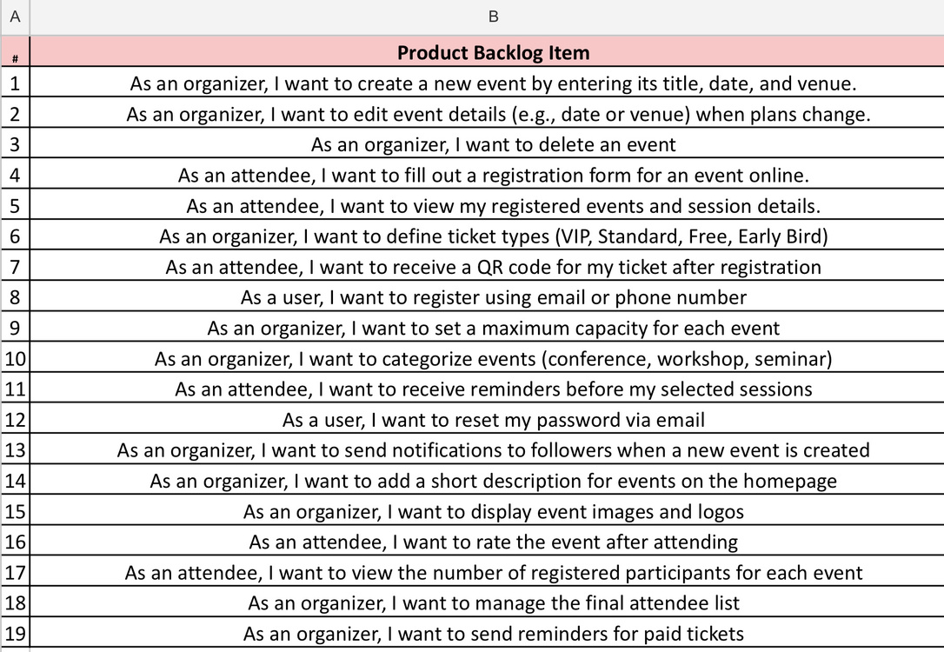
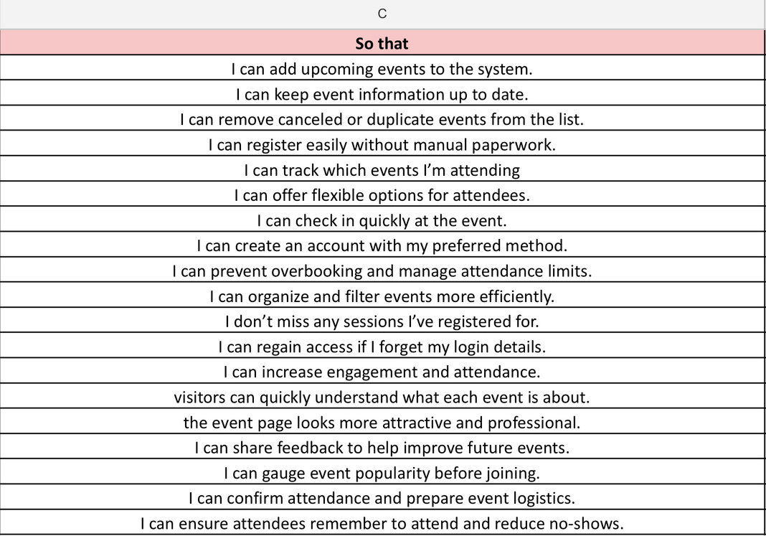
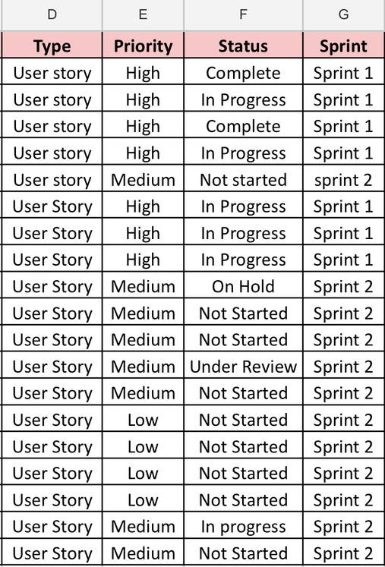
Product Backlog

Slide 8
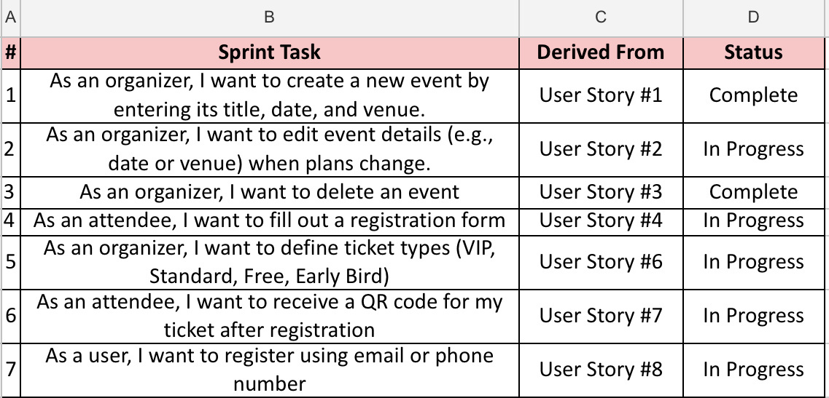
Sprint Backlog

Slide 9

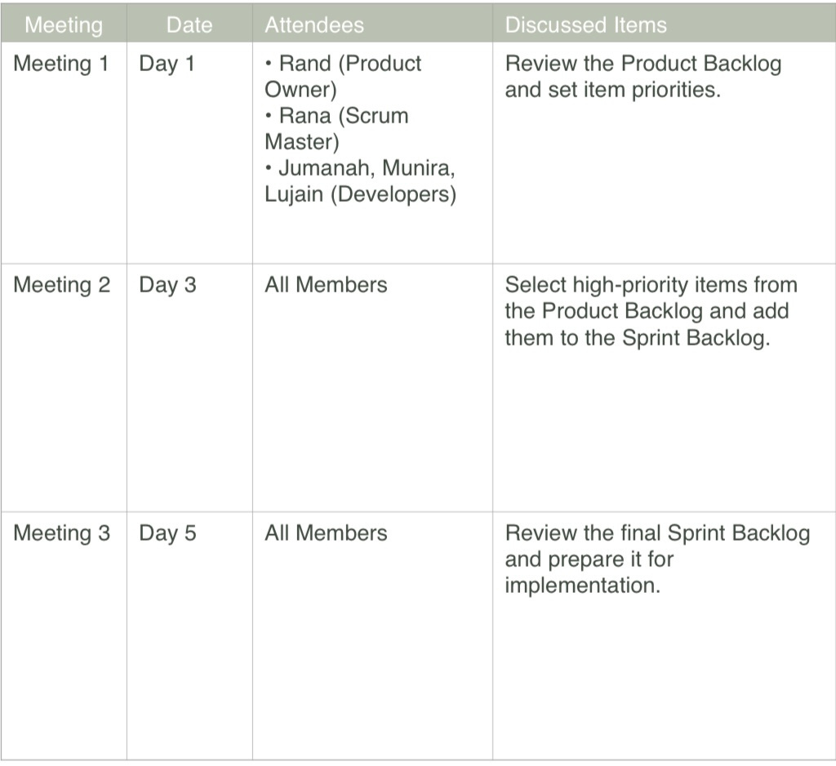
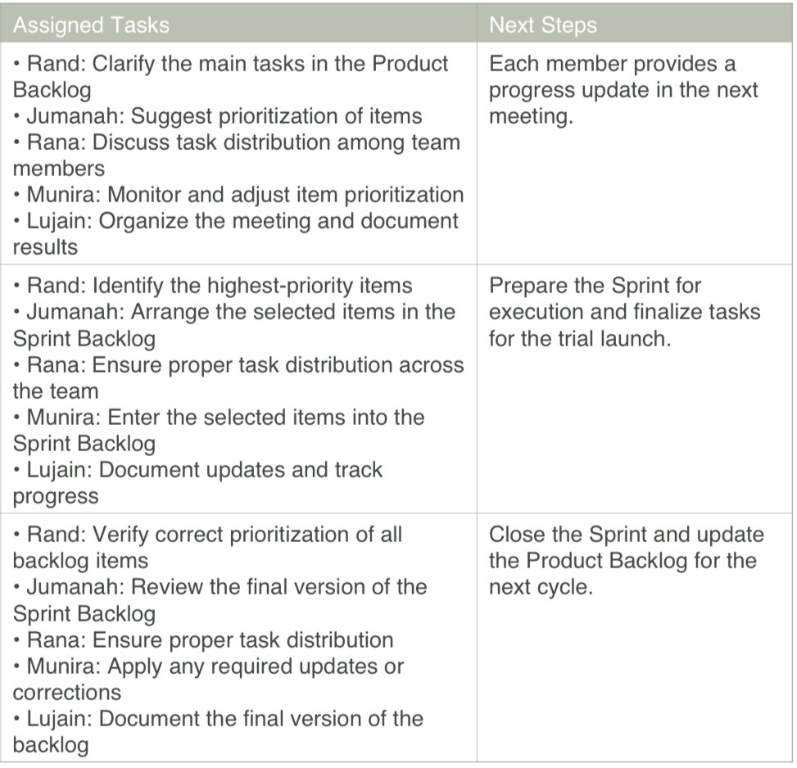
Scrum Meeting

Slide 10
Summary of the product
The Event Management System simplifies organizing and attending events. Organizers can create and manage events, set ticket types, define venue capacities, and send notifications. Attendees can register online, receive QR codes for tickets, and get reminders. The system improves efficiency, reduces manual errors, and enhances the overall event experience for both organizers and attendees.

Slide 11
THANK YOU
FOR ATTENTION

